Slide 1
Stock Market Prediction Using LSTM
By Harsh Sharma

Slide 2
Introduction
“Money is not the most important thing in the world. Love is. Fortunately, I love money."
- Jackie Mason
Notes:
Did you know, In NYSE alone, about 200 Billion USD is being traded on a daily basis.
since so much money flowing in a system. it makes the stock market to be the PLAY GROUND of the RICHES.
It’s like an ocean, an ocean of money. (If you want some, go and get some.) But if you were to go empty handed to an ocean to fetch some water, you would foolish.
You need a basket. Day trading is one such basket or a tool. If you can predict the stock market right, you can make money. It’s highly incentivized to predict the market.
And in the paradigm of Day trading, there’s a very famous term coined these days. “ALOGORITHMIC trading.” Most of the trading performed these days are perfomed by COMPUTERS, running some ALGORITHM; each one of it trying to OUTPERFORM the other.
I’m gonna be covering a glimpse of it.

Slide 3
Introduction
Using an Aritifical RNN architecture called Long Short-Term Memory (LSTM) on the NYSE data for a corporation (APPLE Inc.). For LSTM model, past 60 days data is being considered to train the model.
Notes:
Sequence problem

Slide 4
Data
The data being used is open-source and is provided by New York Stock Exchange (NYSE).
To fetch the data, I’m using Yahoo Finance (yfinance), which is a python library. It is famous for fetching historical financial data.
As preprocessing, I have applied MinMax Normalisation. Also, I truncated a couple of data fields from the data source.
Notes:
Yahoo finance. It conveniently downloads the data in python dataframes which then can be used for analysis and pre-processing. So it’s a good tool.

Slide 5
Data exploration Data preprocessing
(In Jupyter Notebook)
Notes:
Go to notebook.

Slide 6
Methodology – LSTM Architecture
LSTM is a recurrent neural network (RNN) architecture designed to handle long-term dependencies in sequential data.
Input Sequence: "I like"
Output Sequence: "AI.“
Input Sequence: "Machine learning"
Output Sequence: "is amazing.“
Input Sequence: "Recurrent neural networks"
Output Sequence: "can process sequential data."
We’ll tokenize and perform indexing:
"I": 0, “like": 1, "Machine": 2, "learning": 3, "Recurrent": 4, "neural": 5, "networks": 6, "AI.": 7, "is": 8, "amazing.": 9, "can": 10, "process": 11, "sequential": 12, "data.": 13

Slide 7
Methodology – LSTM Architecture
Step 1: Forming Embeddings. We form a dense vector for each input/output sequence
"I like" becomes [0, 1] and "Machine learning" as [2, 3] and “AI” as [7]
Step 2: Feeding the data to Architecture.
The model has three gates: Input, Forget and Output gate.
Step 3: Generate Probabilistic Distribution.
If we are trying to predict the next word after "I like," the model might produce a probability distribution like [0.05, 0.01, 0.01, 0.01, 0.01, 0.01, 0.01, 0.85, 0.01, 0.03, 0.01, 0.01, 0.01].
Notes:
sequential data: time series, speech, and video

Slide 8
Evaluation Metric– RMSE
Root Mean Squared Error measures the average squared difference between the predicted values and the actual values.
Best RMSE Performance: 0.498
In my attempts to find the ideal hyperparameters, RMSE went as high as 15.
Notes:
Show notebook and graph of predicted vs real

Slide 9
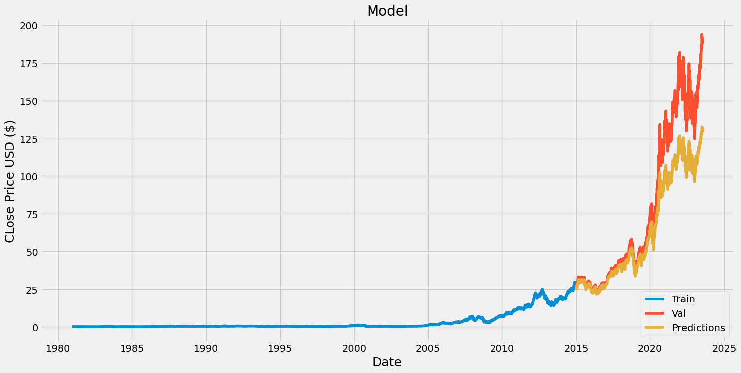
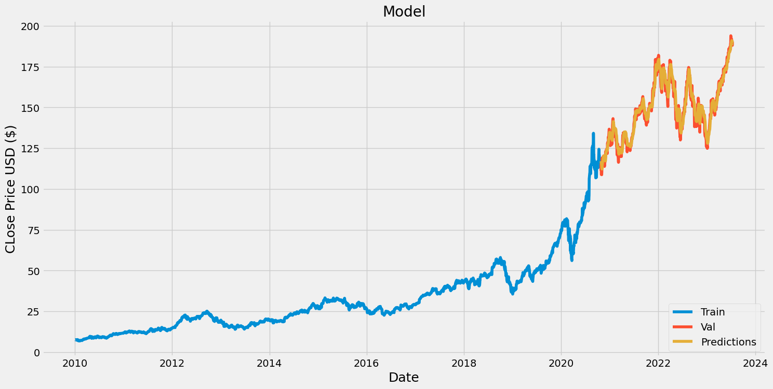
Experiment Setting
For training the model, I’m considering the data from 2010 to 2023. Although, I’ve tried different ranges of data, going all the way back to 1981 (the year APPLE Inc. was listed)
The general intuition is more the data, the better is the model trained. It wasn’t the case in my analysis.
Bad Performing model with large dataset
Better Performing model with small dataset
Notes:
sequential data: time series, speech, and video

Slide 10
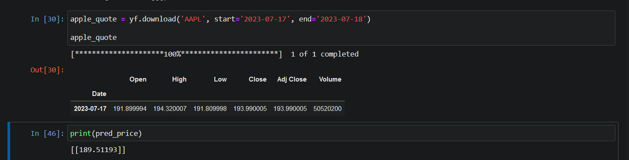
Results
The model has been fairly consistent in predicting the closing stock price of APPLE stock.

Slide 11
Demo

Slide 12
Conclusion
The LSTM model performed well on the NYSE sequential stock data. The trained model was able to provide output with closing price for the next day. Although these predictions weren’t always close to the actual values. But the RMSE score of 0.49 gives us a good metric that the model has been predicting values very close to the actual ones.

Slide 13
References
https://www.nyse.com/index
https://chat.openai.com/
https://docs.streamlit.io/library/get-started
https://www.youtube.com/
https://www.geeksforgeeks.org/deep-learning-introduction-to-long-short-term-memory/#
https://www.analyticsvidhya.com/blog/2021/03/introduction-to-long-short-term-memory-lstm/

Slide 14
Thank you

